Slide 1
DEVICES AND COMMUNICATION BUSES FOR DEVICES NETWORK

Slide 2
EMBEDDED COMMUNICATION SYSTEM
Based on interconnect
  Point to point network (data link)
  Shared media networks (data high ways)
Based on bits transferred
  Serial communication
    Asynchronous
    Synchronous
    Eg: RS232, RS422, RS485, UART, USART, CAN, USB, I2C,SPI
  Parallel communication
    IEEE – 488, Cetronics parallel protocol

Slide 3
Serial communication
Synchronous: Bit by bit at regular intervals of time
Advantages:
  Only half – duplex or full duplex wires are required to send / receive data.
Low cost due to low number of wires.
Disadvantage
  Lower speeds than parallel transmission.
Asynchronous: Bit by bit using start and stop bits.
  Disadvantage
  Lower speeds than parallel transmission.

Slide 4
RS 232
Asychronous data transmission
Capable of full – duplex communication
Data terminal equipment (DTE) and data communication equipment (DCE)
Independent channels are established for two way communication.

Slide 5
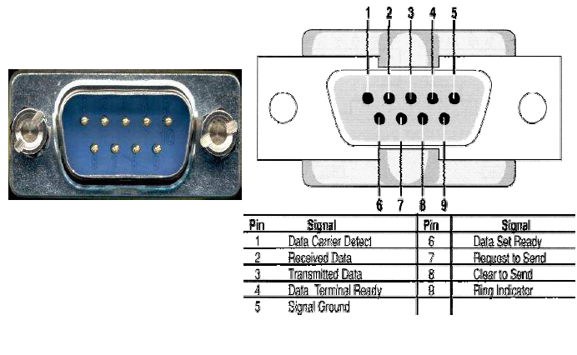
Pin details of RS 232

Slide 6
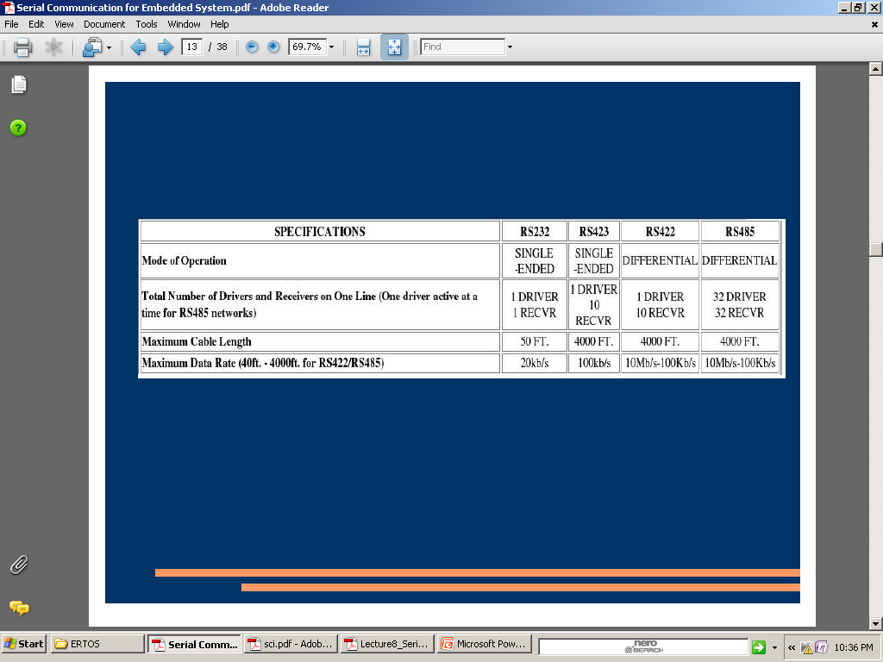
Comparision

Slide 7
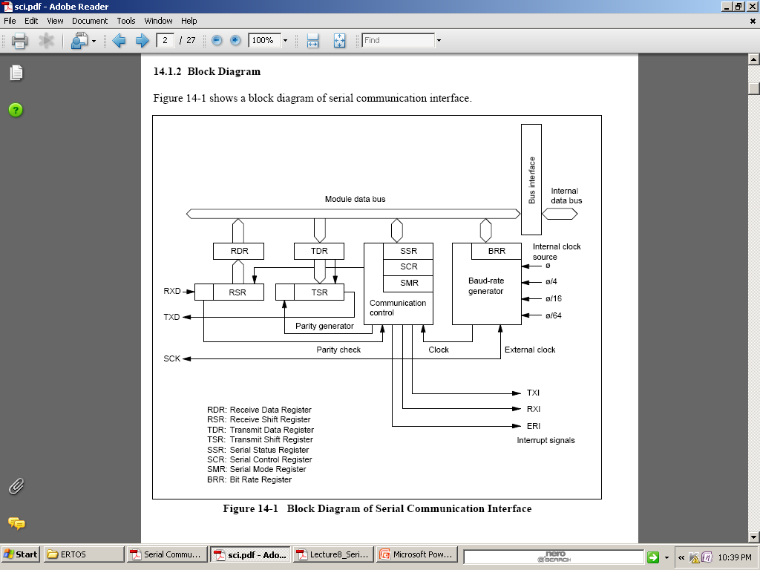
Serial communication interface

Slide 8
Data Word
Start Bit
  Signals the start of transmission of the data bits
  Transition from logic 1 to logic 0
Data Bits
  Generally 8 data bits (not including parity bit)
  Transmitted and received least significant bit first
Stop Bit
  Signals the end of a data word
  Logic 1

Slide 9
Parity Bit
Can be added to the transmitted data to check for and display an error message when a bit is lost during transmission
Comes in two forms
  Odd Parity
    Sum of the 1’s in the frame will be odd
    The logical state (1 or 0) of the parity bit is selected to fulfill this condition
  Even Parity
    Sum of the 1’s in a frame will be even
Number of 1’s checked against the parity bit to determine if any bits were lost during transmission
A two bit loss will go undetected with this method

Slide 10
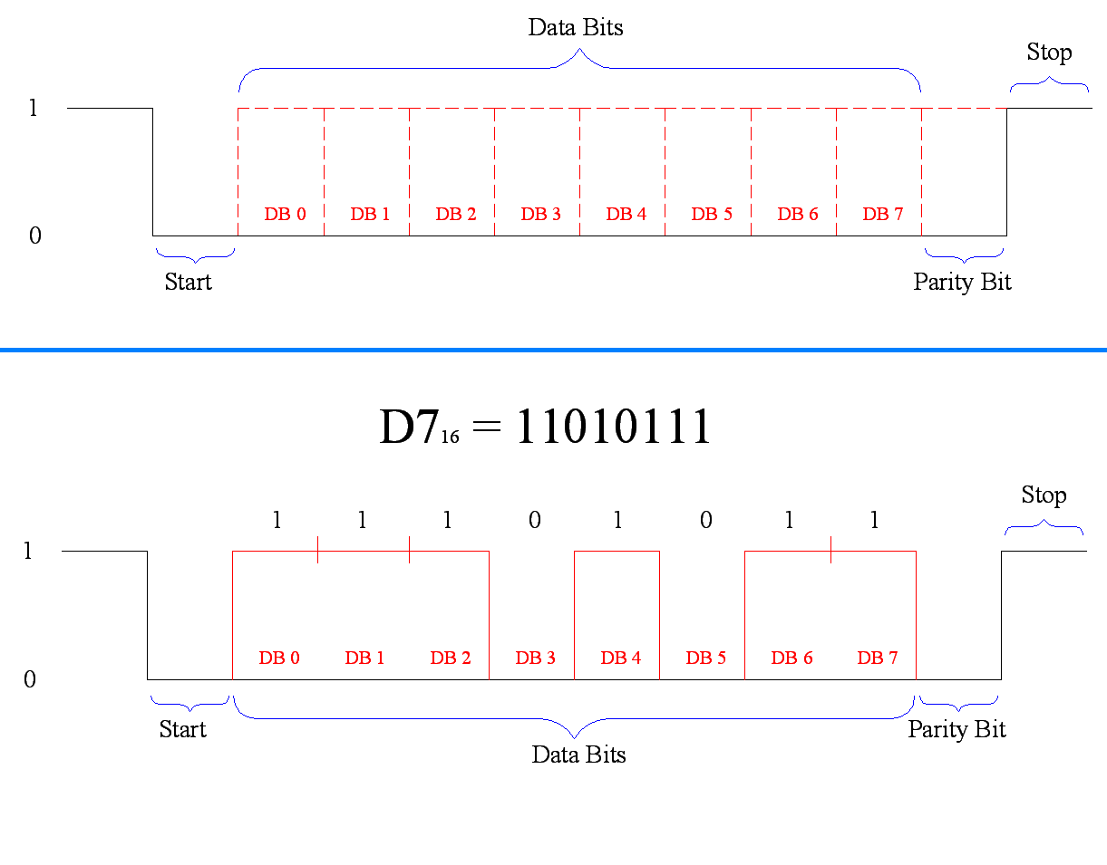
Data Word

Slide 11
Baud and Bit Rates
Baud Rate
  A baud is the “reciprocal of the shortest pulse duration in a data word” inclusive of start, stop, data, and parity bits
  Baud rate is the total number of bits transmitted per second
Data Bit Rate
  The number of data bits transmitted in one second.
  Does not include the start or stop bits

Slide 12
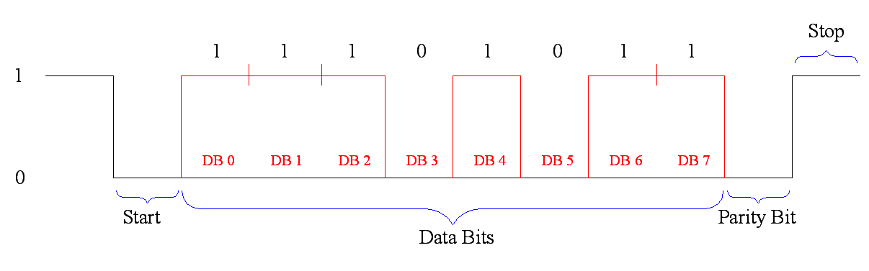
In this example:
1 start bit, 1 stop bit, 1 parity bit, 8 data bits, 11 bits per word, 300 baud rate
Bit Time = 1/(Baud rate) = 1/300 = 3.33 msec
Character Time = (total bits in word) x (bit time) = 11 x 3.33 = 36.6 msec
Data Bit Rate (including parity) = (data bits in word)/(character time)= 9/3.33 = 270

Slide 13
SCI Registers
BAUD – sets bit rate
SCCR1 (Control Register 1) – contains control bits related to the 9-bit data character format and the receiver wake-up feature
SCCR2 (Control Register 2) – main control register for the SCI subsystem
SCSR (Status Register) – generate hardware interrupt requests and indicate errors in the reception of a character
SCDR (Data Register) – main data register for transmitting and receiving (contains a buffer)

Slide 14
BAUD Register
Address: $102B
Bit 7 6 5 4 3 2 1 0
Read:
Write:
Reset:
0
0
0
SCP1
SCP0
SCR2
SCR1
SCR0
TCLR
RCKB
0 0 0 0 0 U U U
TCLR – clear baud rate timing chain bit (factory testing of MCU)
SCP1-SCP0 – baud rate prescale select bits (determines highest available baud rate in system)
RCKB – baud rate clock test bit (factory testing of MCU)
SCR2-SCR0 – baud rate select bits (selects an additional binary submultiple of the highest baud rate)
Bits are determined based on the baud rates found in Table 9-3 of HC11 Reference Manuel

Slide 15
SCCR1 Register
Address: $102C
Bit 7 6 5 4 3 2 1 0
Read:
Write:
Reset:
WAKE
R8
0
0
0
0
T8
M
U U 0 0 0 0 0 0
R8 – receive data bit 8 (acts as extra bit of RDR)
T8 – transmit data bit 8 (acts as extra bit of the TDR)
M – SCI character length bit (controls the character length for both transmitter and receiver at same time)
WAKE – wakeup method select bit
  Idle line – detection of at least a full character time of idle line
  Address mark – a logic 1 in MSB

Slide 16
SCCR2 Register
Address: $102D
Bit 7 6 5 4 3 2 1 0
Read:
Write:
Reset:
TIE
TCIE
RIE
ILIE
TE
RE
RWU
SBK
0 0 0 0 0 0 0 0
TIE – transmit interrupt enable bit
TCIE – transmit complete interrupt enable bit
RIE – receive interrupt enable bit
ILIE – idle-line interrupt enable bit
TE – transmit enable bit
RE – receive enable bit
RWU – receiver wakeup bit
SBK – send break bit

Slide 17
SCSR Register
Address: $102E
Bit 7 6 5 4 3 2 1 0
Read:
Write:
Reset:
TDRE
TC
RDRF
IDLE
OR
NF
FE
0
1 1 0 0 0 0 0 0
TDRE – transmit data register empty bit (see if SCDR can accept new data)
TC – transmit complete bit
RDRF – receive data register full bit
IDLE – idle-line detect bit (full character time of logic 1 on the RxD line)
OR – overrun error bit (received character was not read before new character was sent)
NF – noise Flag
FE – framing error bit (logic 0 is detected where stop bit was expected)

Slide 18
SCDR Register
Address: $102F
Bit 7 6 5 4 3 2 1 0
Read:
Write:
Reset:
R7
R6
R5
R4
R3
R2
R1
R0
T7
T6
T5
T4
T3
T2
T1
T0
U U U U U U U U
When SCDR is read , the read-only RDR is accessed
When SCDR is written, the write-only TDR is accessed

Slide 19
Port D Related Registers
PORTD
  SCI uses the two LSB’s for input/output
DDRD – data direction register for port D
  Is not used while SCI is in use but will take over control of port D when the SCI operation is aborted

Slide 20
Steps for Transmitting Data
Set Baud rate ($102B) to equal receiver
Set TE in SCCR2 ($102B) high to enable
Set Wake Up mode in SCCR1 ($102C)
TE sends idle character to wake receiver
Receiver determines if message is intended for it
Load character into SCDR ($102F)
Character placed in shift register and shifted out
When TDRE in SCSR ($102E) sets back to 1, load another character (both polling and interrupts can be used)
Transmission complete (TC in SCSR)
Idle line rests at logic 1, RWU goes to 0

Slide 21
Steps for Receiving Data
Set Baud rate in Baud register ($102B)
Set bit 4 in SCCR1 ($102C) to select 8 or 9 bit characters; set bit 3 to select wake up mode
Set bit 2 in SCCR2 ($102D) to enable receiver; set bit 4 to enable interrupt on idle; set bit 5 to enable interrupt when character received or overrun occurs
Read status of receive from SCSR ($102E) Bit 5 will be set when data is received; framing error sets bit 1; noise sets bit 2; overrun sets bit 3; idle sets bit 4
Read data received from SCDR ($102F)
If 9 bit data format is used, the ninth bit of data will be located in bit 7 of SCCR1 ($102C)

Slide 22
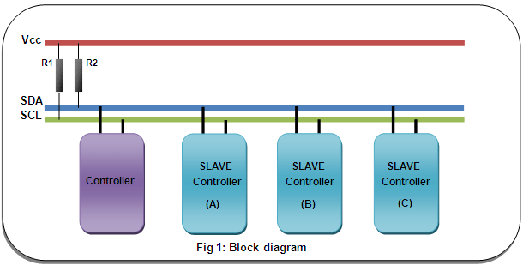
I2C

Slide 23
Serial peripheral interface
Synchronous bus developed by Motorola.
Can achieve better speeds than I2C.
Master slave relationship.
Duplex capability hence advantageous to DSP
Bit rate is 38.4kbps
9.6kbps for 68HC11.

Slide 24
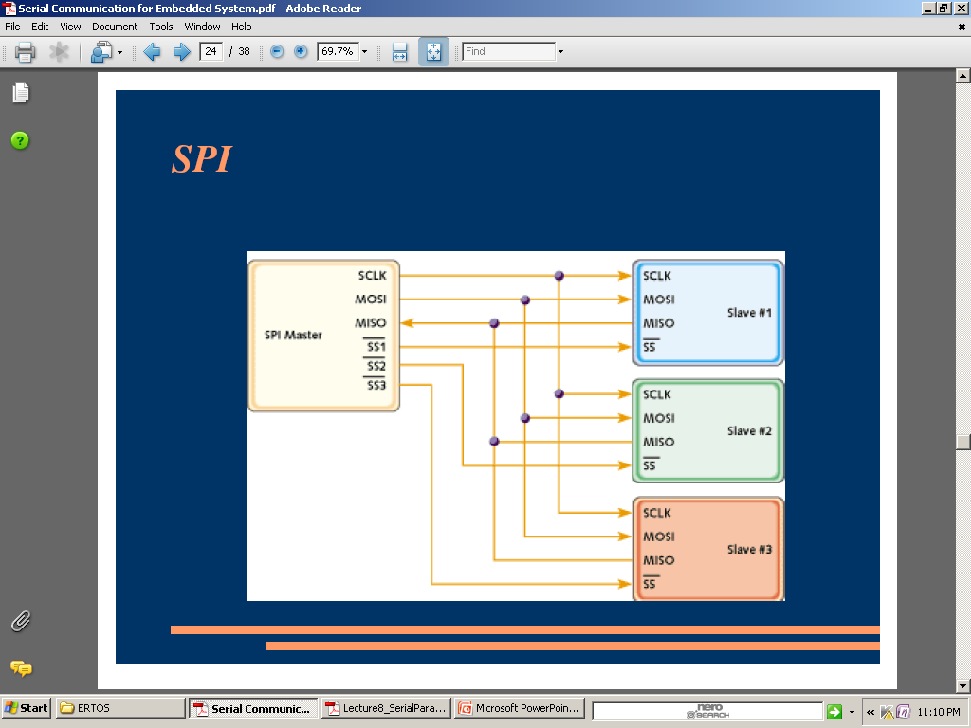
SPI

Slide 25
Serial interface port
USART
There is on – chip common hardware device.
Bit rate is 20Mbps.

Slide 26
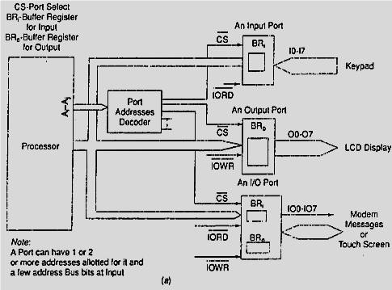
Parallel Device Ports

Slide 27
Parallel port
Transfers number of bits over the wires in parallel.
Parallel wires capacitive effect reduces the length up to which parallel communication can be done.
This results in delay, noise and cross talk.
A parallel device port has input pins, output pins, status pins, control pins.
Parallel port inputs I0-I7 used as a keypad controller.
Parallel port outputs O0-O7 used as the output bits to the LCD display output controller.

Slide 28
Parallel port
BRi and BRo are the input and output data buffers at bi-differential IO port.
A device port connects to the address bus signals, Ai and Aj through a port address decoder.

Slide 29
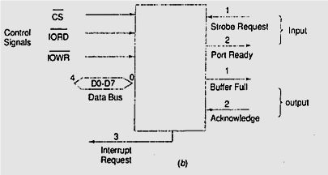
Handshake signals

Slide 30
Handshake signals
An external input device to the device port makes a strobe request, STROBE, after it is ready to send the byte and the system IO device sends the acknowledgement , PORT READY when BRi( receiveing buffer) is empty.
An external output receiving device sends the message ACKNOWLEDGE when IO device port ends the BUFFER FULL signal.

Slide 31
Handshake signal
The processor will send the INTERRUPT REQUEST message when BRo transmitting buffer is empty not full (available for next write) or when the receiving buffer is full (available for next read).
This enables the processor to interrupt and retransmit next byte(s) in next cycle or receive the byte(s) from input using the appropriate service routines for output (or) input from the port, repectively.

Slide 32
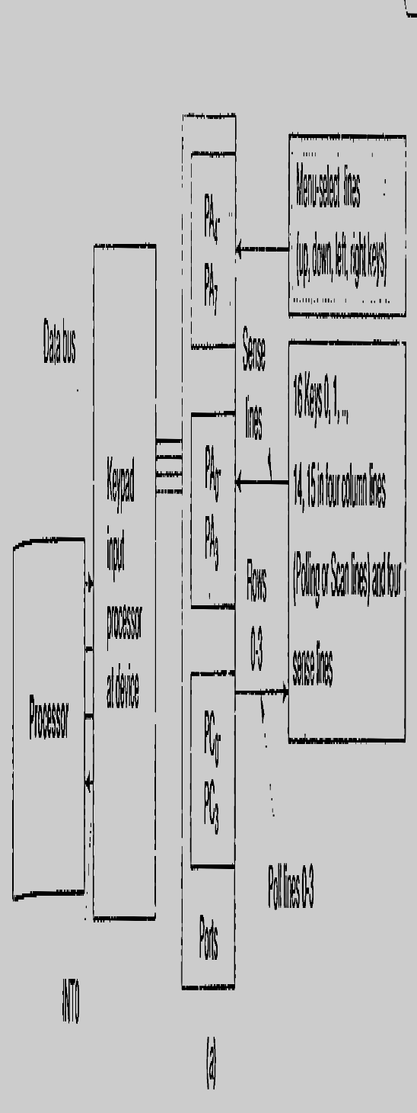
Parallel port interfacing with switches and keypad

Slide 33
Parallel port interfacing with switches and keypad
A 16 keys keypad has many applications.
A mobile smart phone device has 16 keys and four menu.
Arranged in four rows and four columns.
The processing element computes the code of the pressed key and generates a status signal when a key is found pressed.
From the bit pattern found at A0-A3, the processing element computes 7-bit ASCII code of the pressed key at that instance and outputs that code at D0-D6.

Slide 34
Sophisticated Interfacing Features in Device Ports
A port device may not be as simple as

